Slide 1
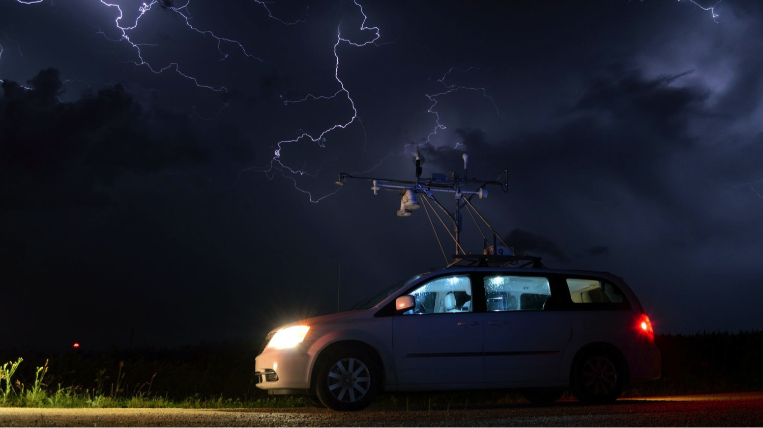
Photo: Andy Wade, PECAN 2015

Slide 2

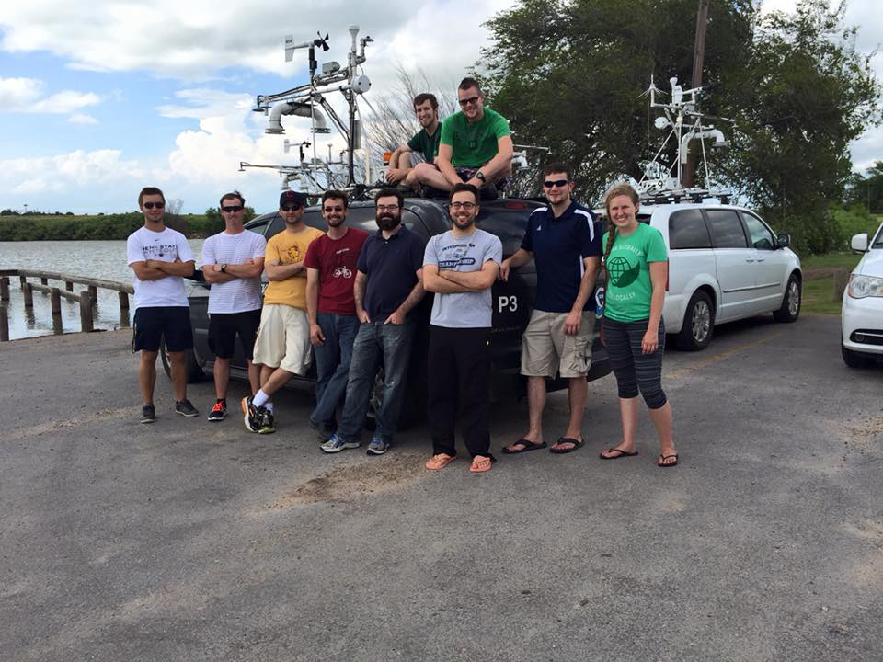


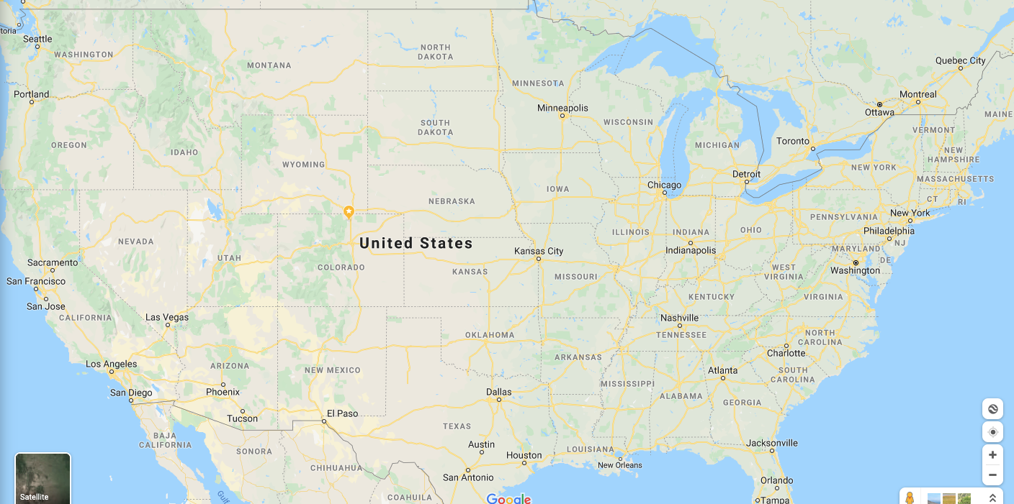
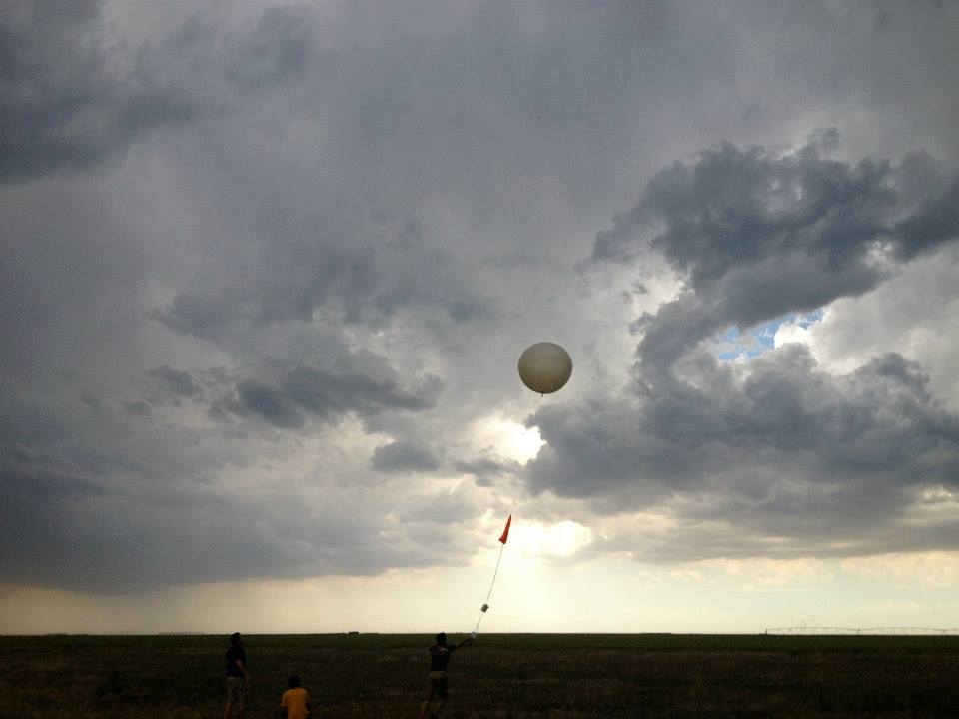

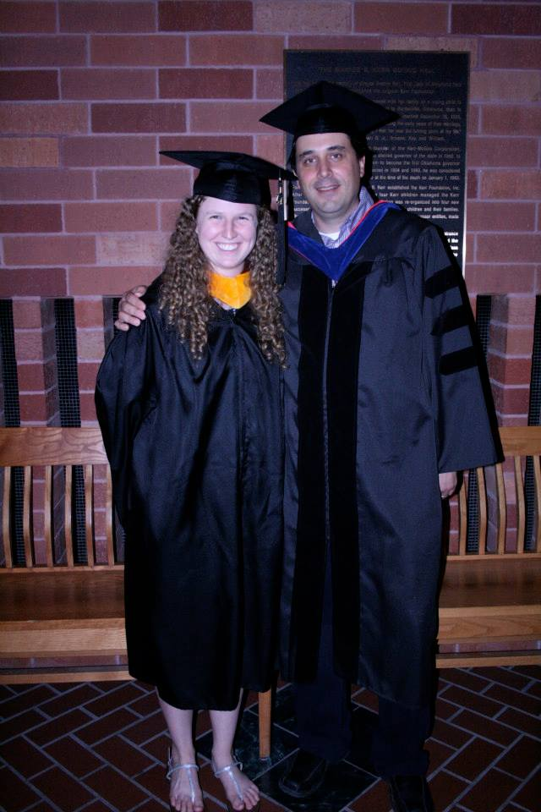

Who am I?

Slide 3
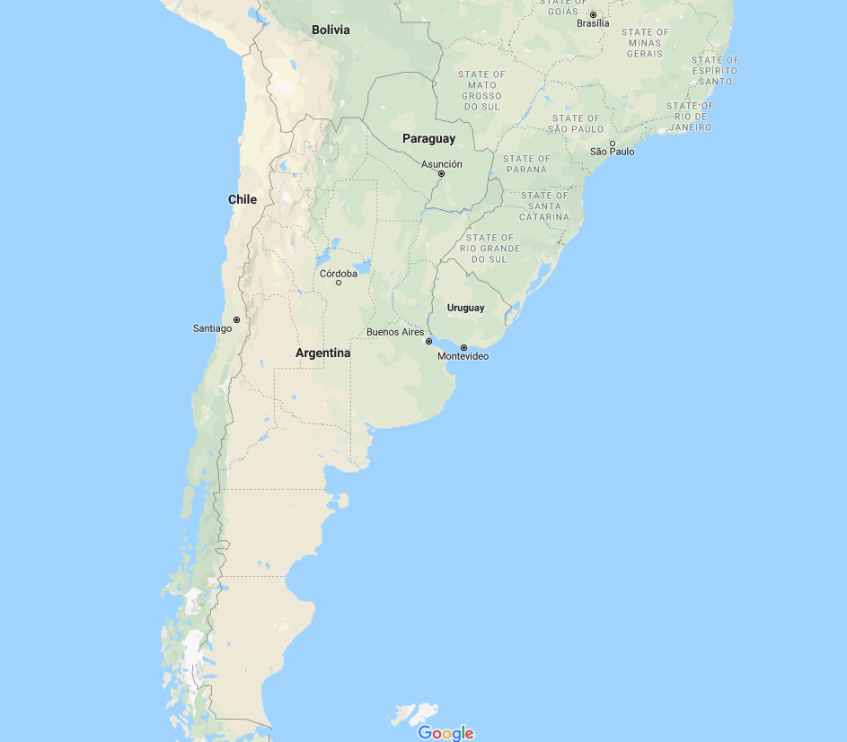
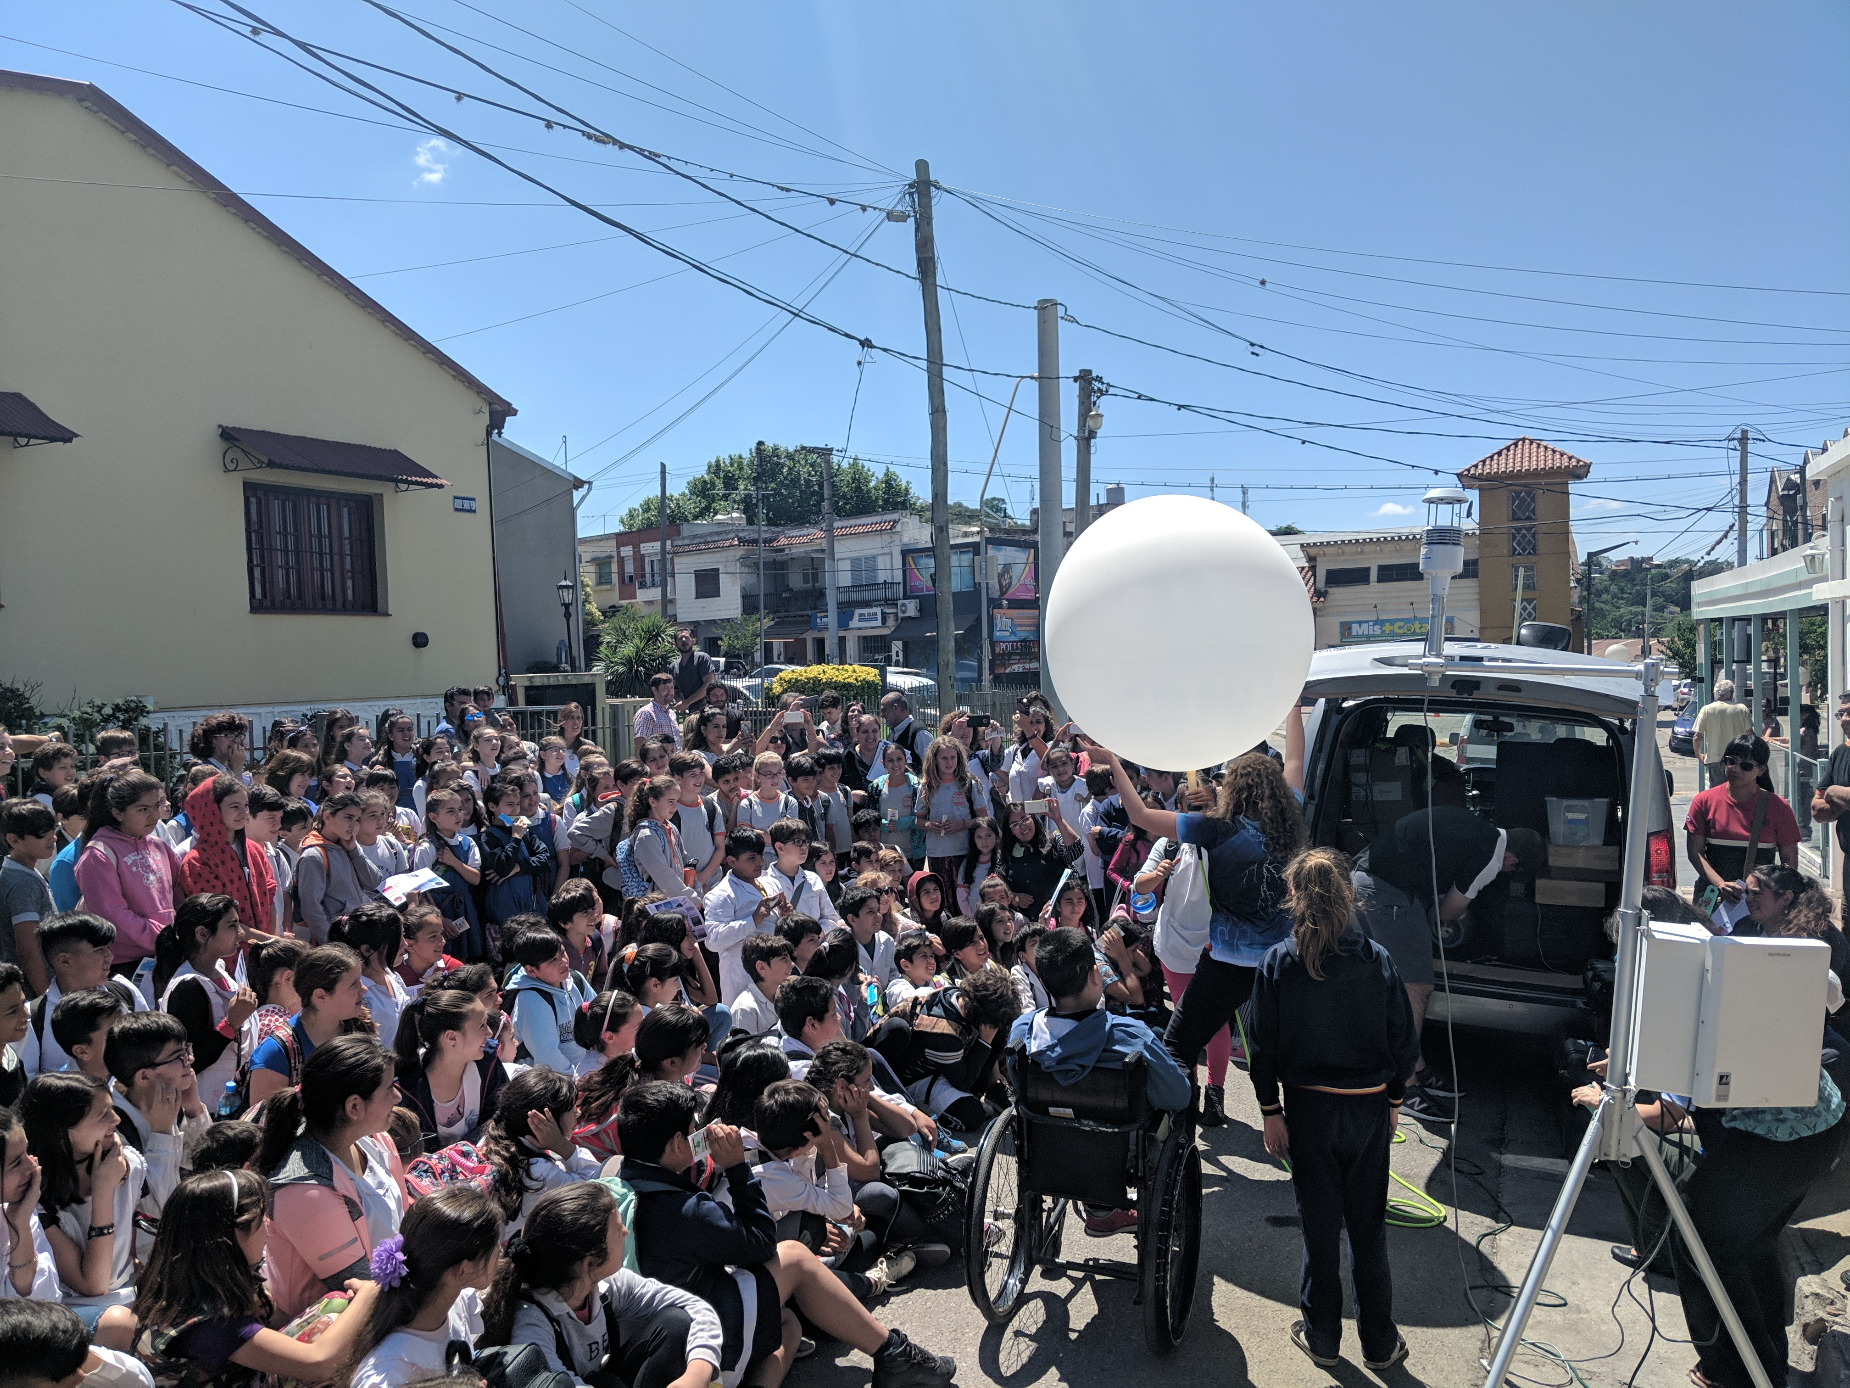

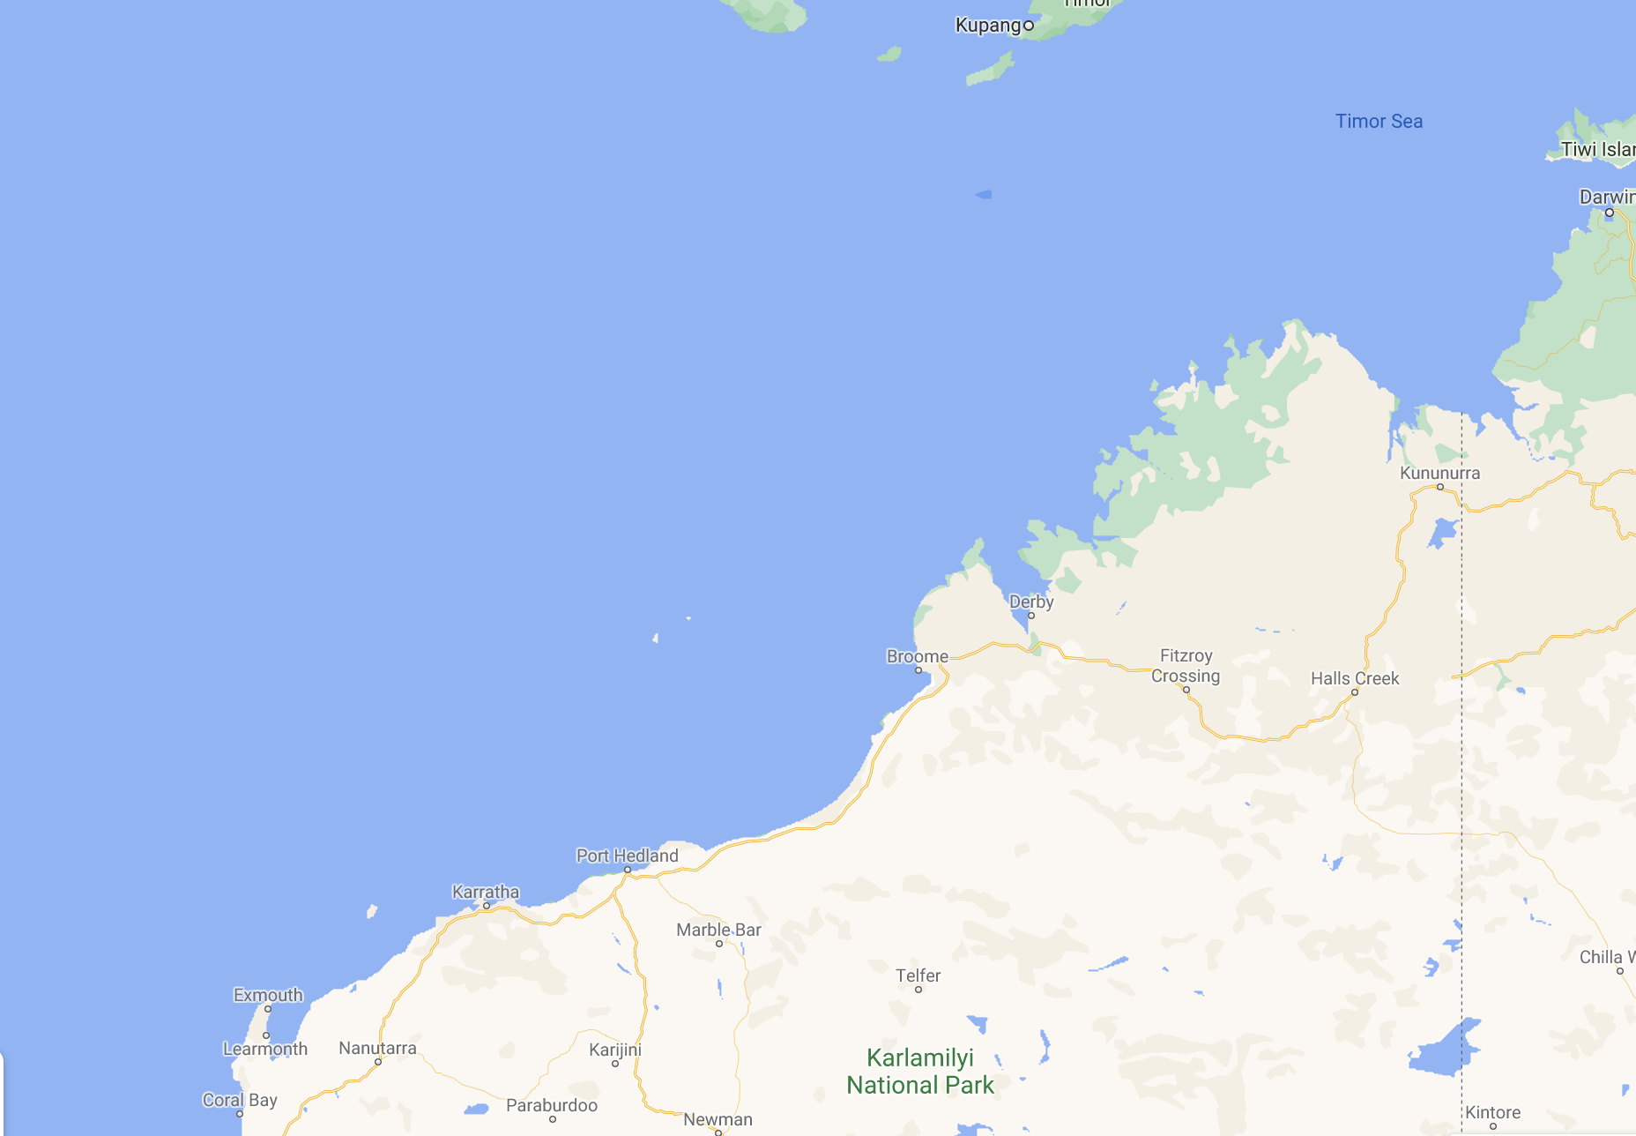


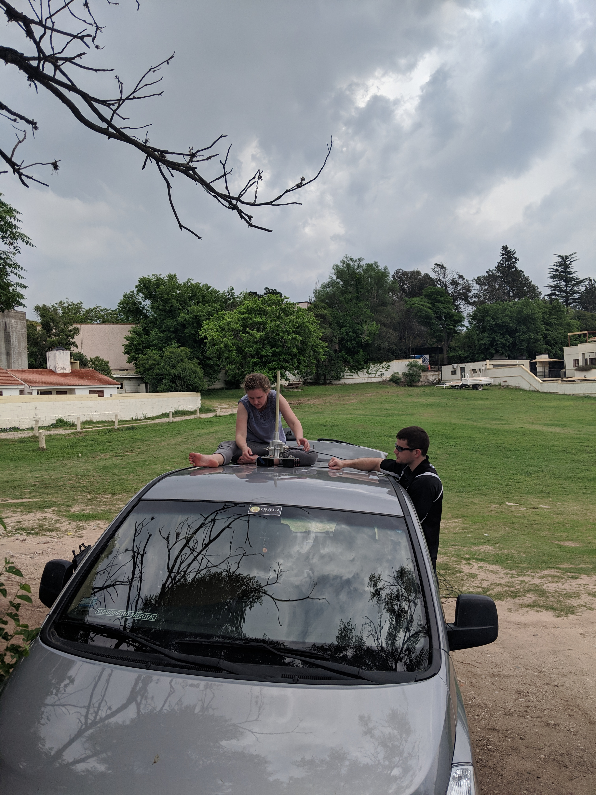
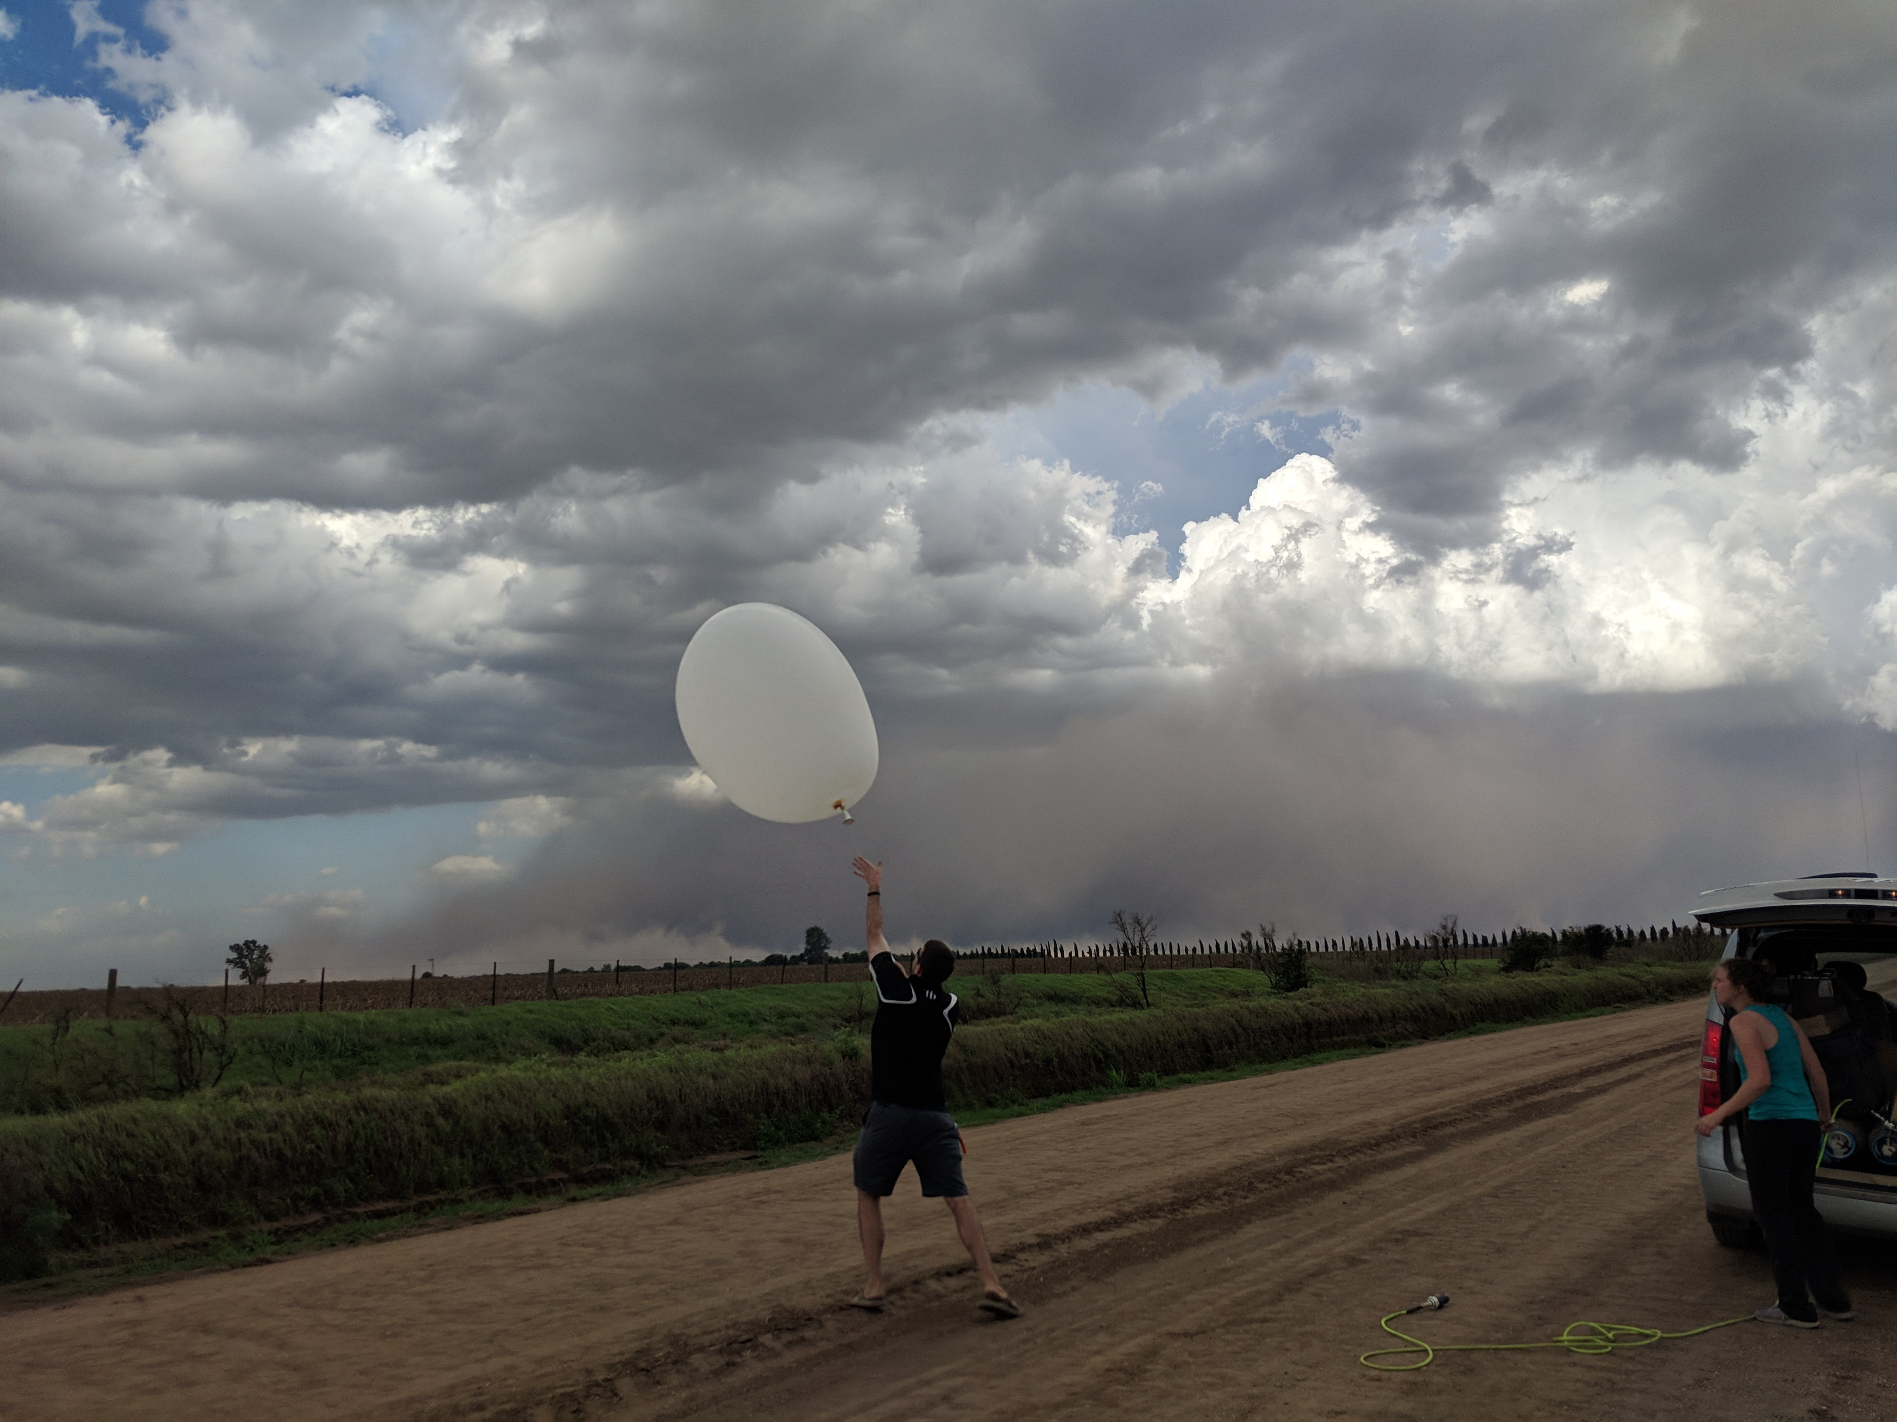

Slide 4

What is a thunderstorm?
Convective storm (cumulonimbus cloud) with lightning and thunder
Role: Redistribute energy
Immediate impacts: rainfall, flash flooding, winds, hail, tornadoes, lighting, turbulence
Other impacts: Forecast skill of downstream predictions, subsequent/future storms, large scale climate drivers, radiational feedbacks
Notes:
What is their purpose? Redistribute energy (reduce instability)
Other useful info:
Convection: is defined by the ability of parcels to rise because they are less dense than their surroundings
Deep convection
Lightning is usually indicative of mixed-phase precipitation (i.e. both liquid and ice).

Slide 5
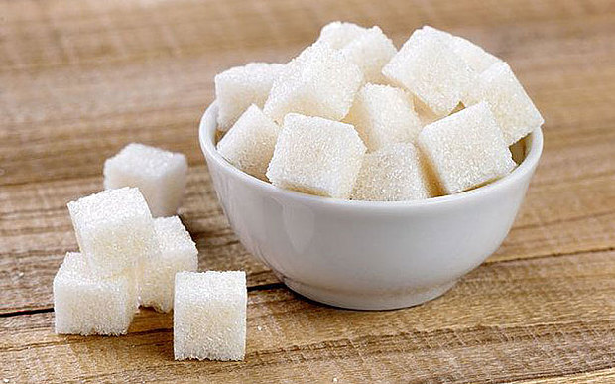
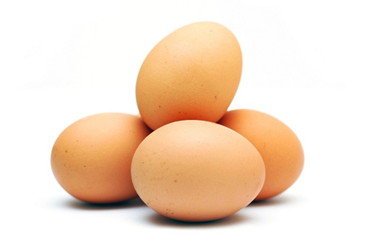


What are the key ingredients of a thunderstorm?
Moisture: Needed for clouds! Moist air also has lower lapse rate than dry air (cools more slowly). Why?
Instability: Air needs to be less dense than its surroundings to rise to high elevations
Lift (trigger mechanism): Something that forces air to rise
Trigger Mechanisms:
Fronts
Low-level convergence
Low-level warm air advection
Low-level moisture advection
Outflow and sea-breeze boundaries
Orographic upslope
Frictional convergence
Vorticity
Jet Streak
Without all three, a thunderstorm will not develop.
Notes:
A parameter often used to demonstrate the potential for thunderstorms based on these criteria is CAPE.
Note that different types of instabilities exist…

Slide 6
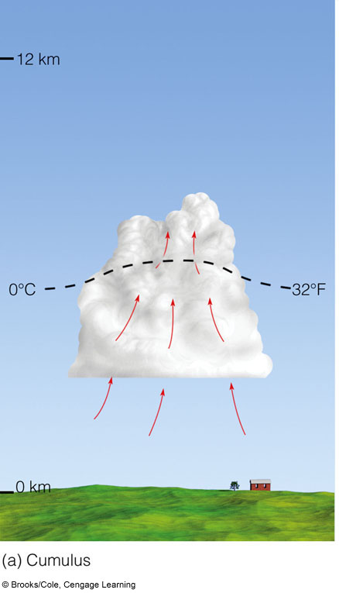
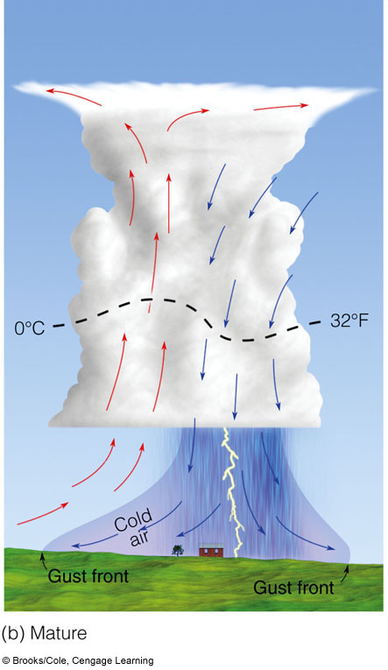
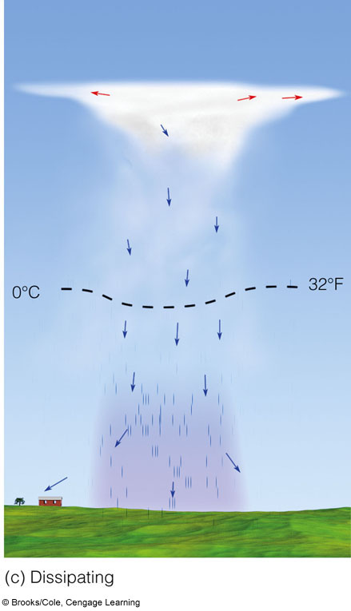
Thunderstorm fundamentals

Slide 7
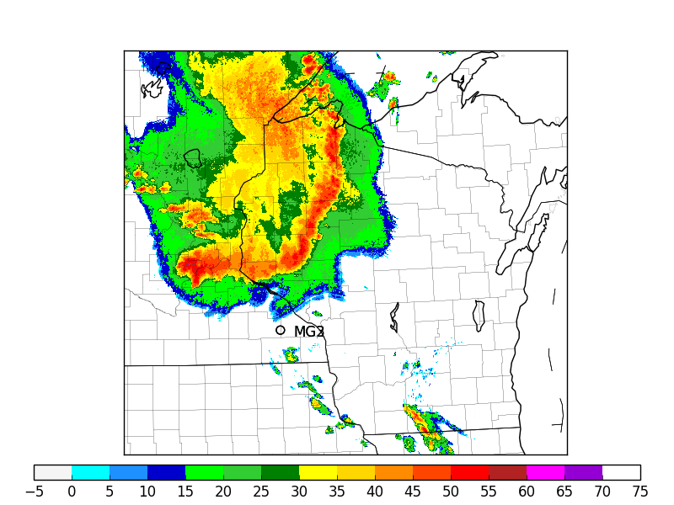
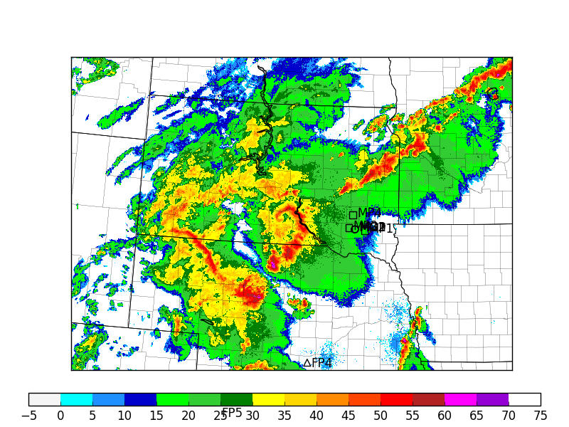
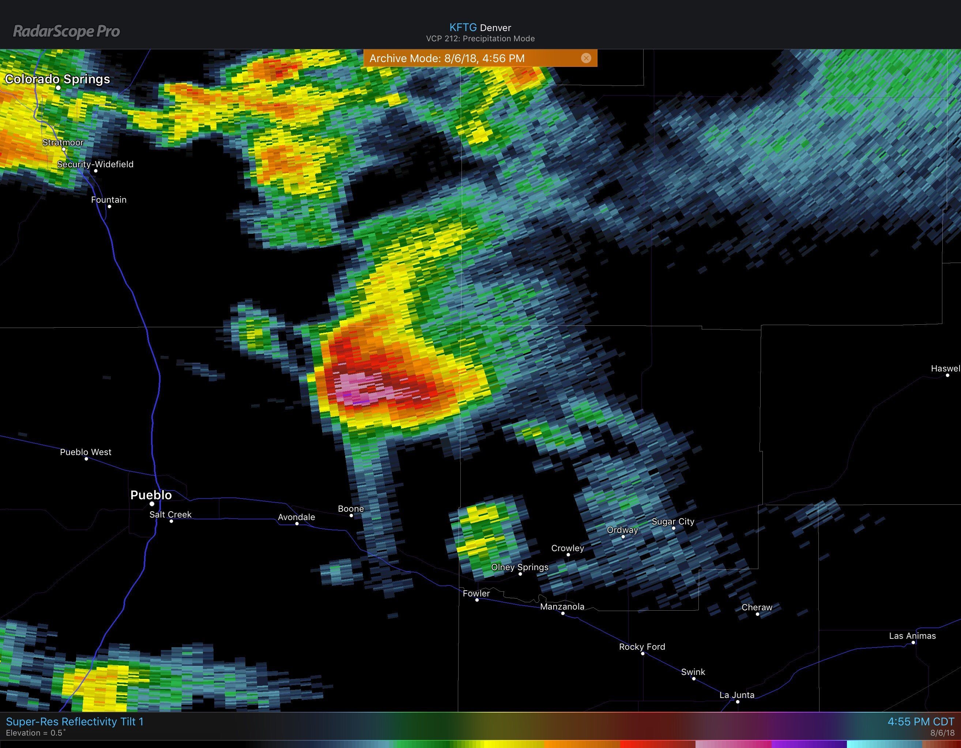
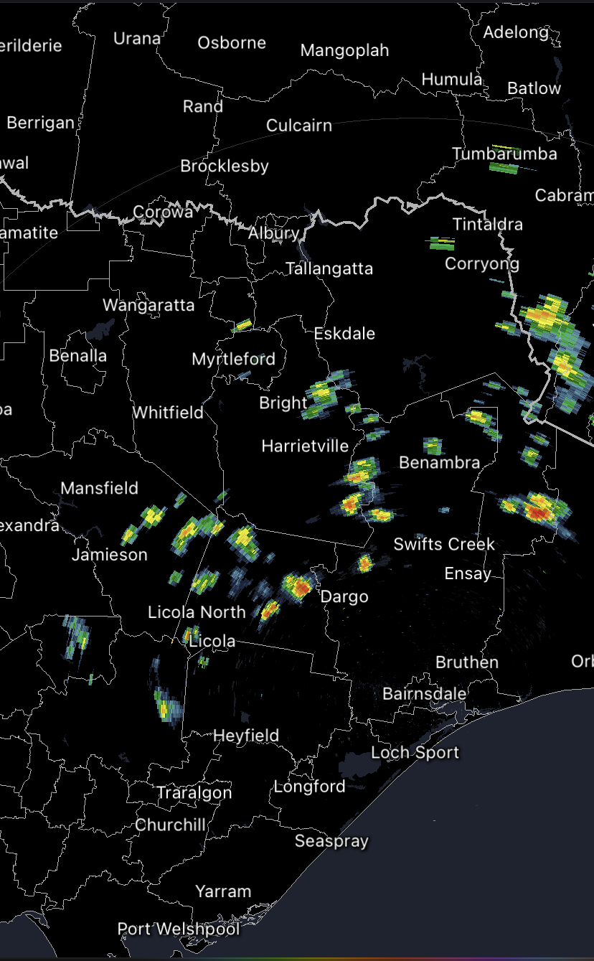
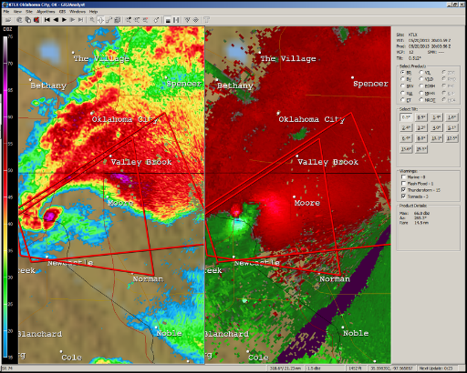
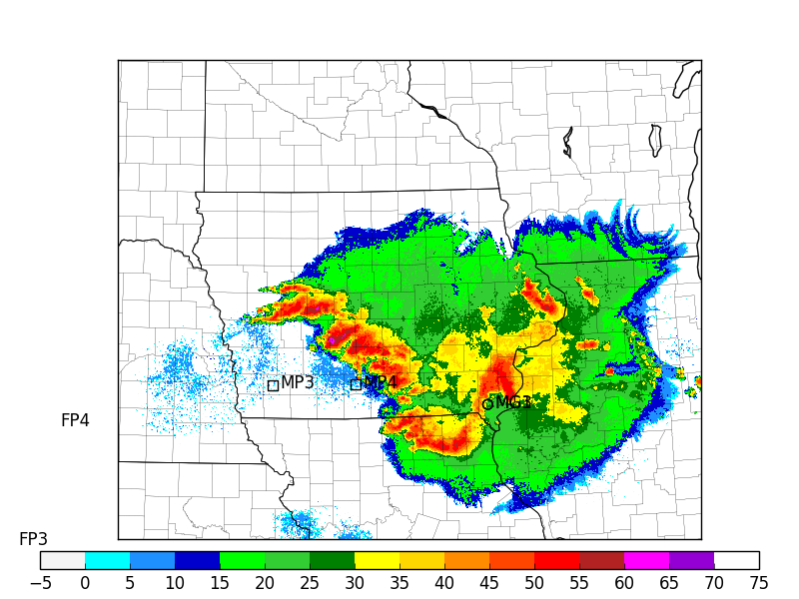
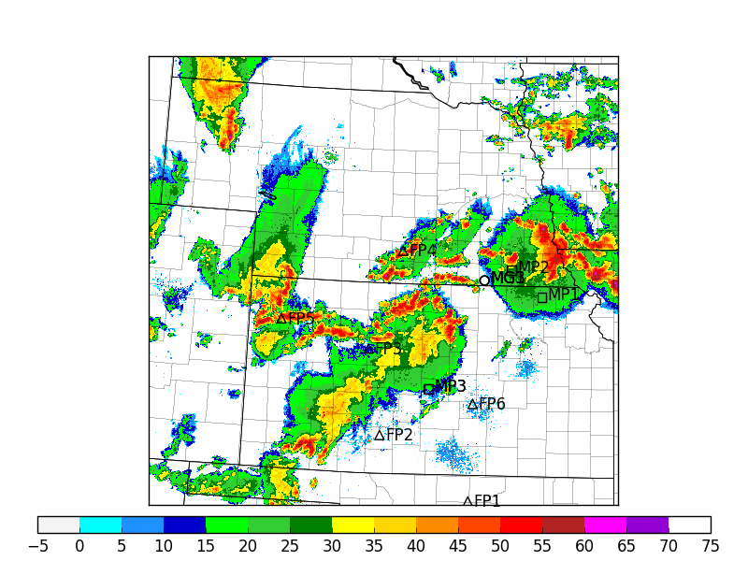
Thunderstorm (or convective) organization determines how they impact people
(brief) tornado
Damaging wind
Hail
Wind
Heavy rainfall
Tornado
Nothing
(but rain, lightning)
25 km
Mostly just rain,
lightning
50 km
250 km

Slide 8
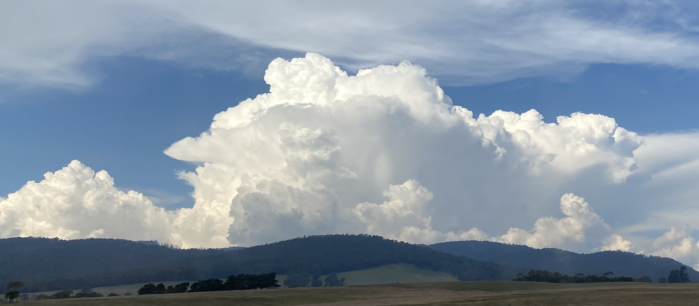
Vertical wind shear plays a key role in organization

Slide 9
Recognizing thunderstorm structures
Michael Coniglio, TORUS 2019

Slide 10
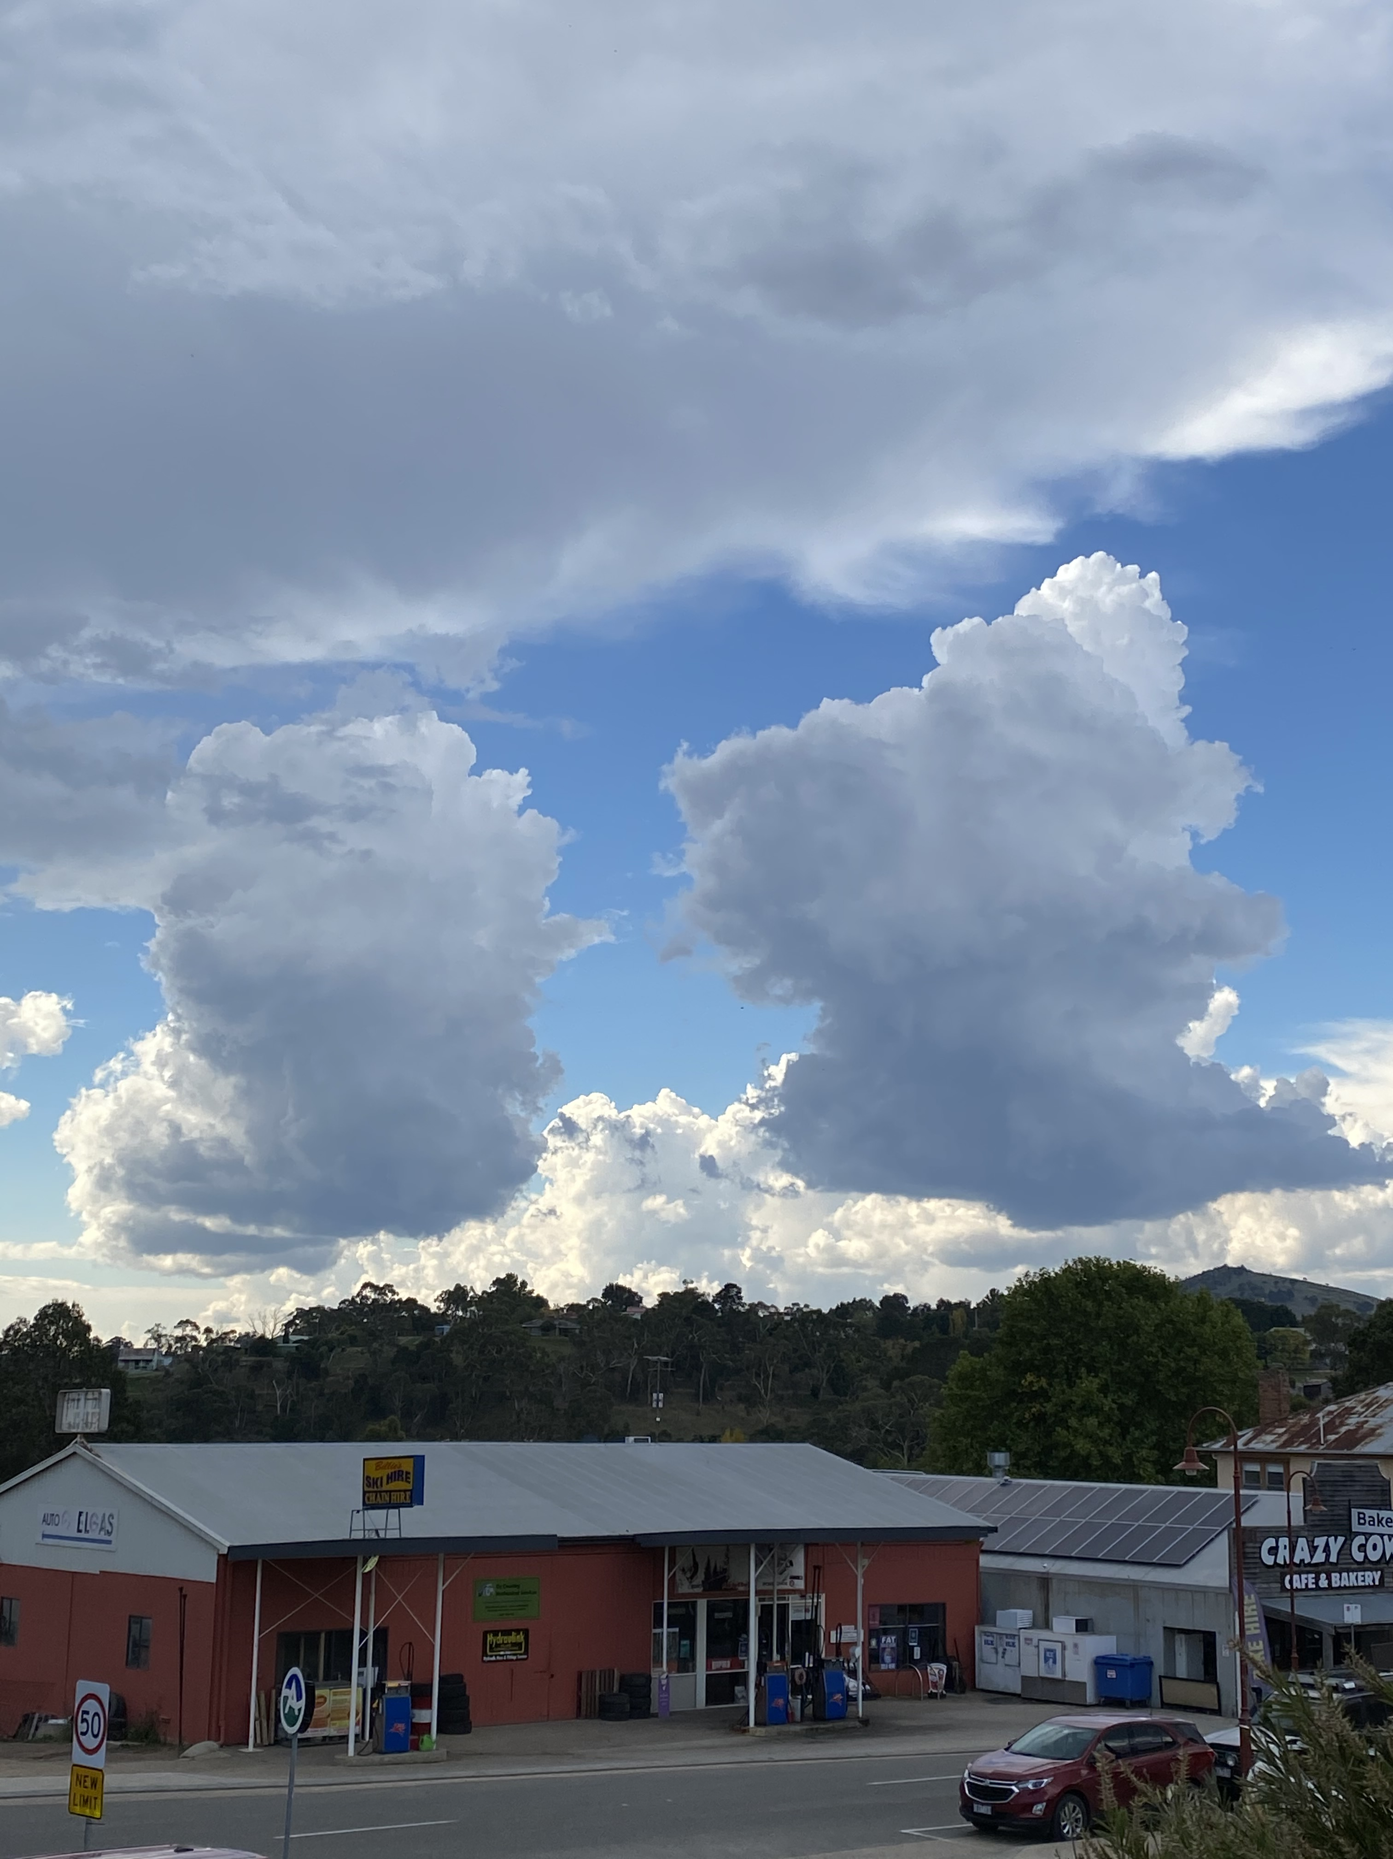
Example from last month…
Stacey Hitchcock, 2021

Slide 11
Anvil
Anvil
Mature → decaying cell
Mature cell
Updraft base
rain
Stacey Hitchcock, 2019 RV Investigator Voyage YMC

Slide 12
mammatus
Updraft (or what’s left of it)
virga
Stacey Hitchcock

Slide 13
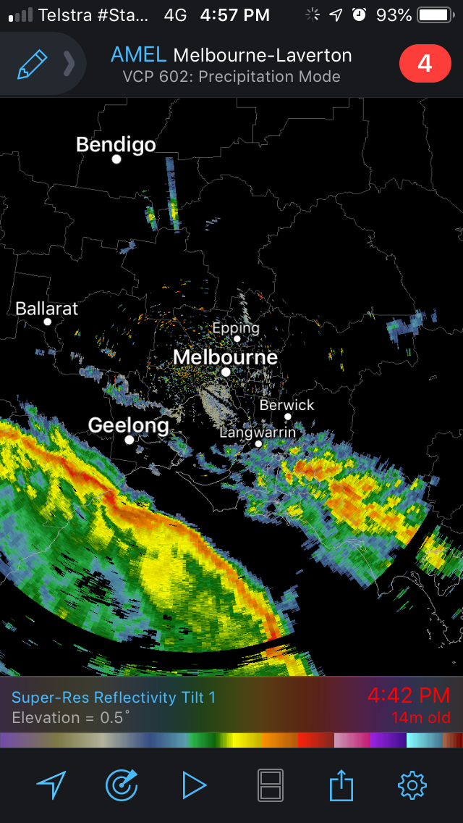
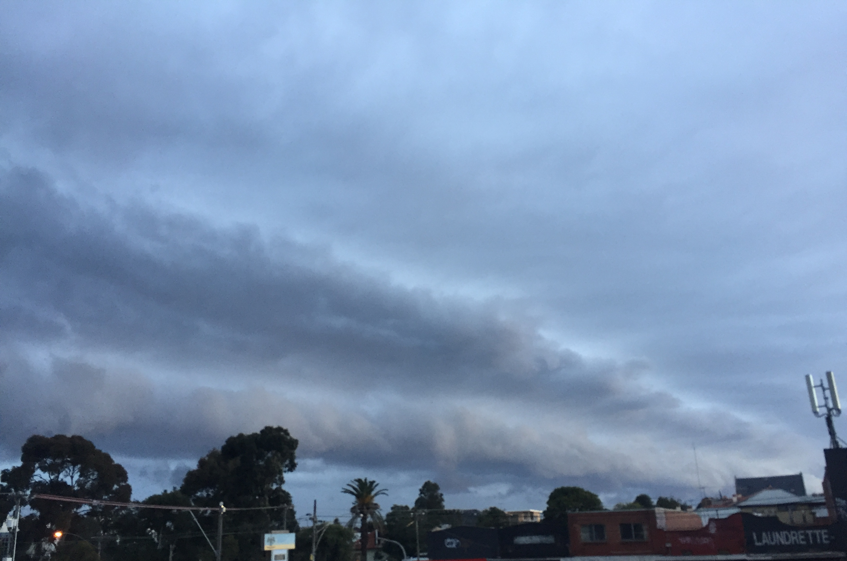
Squall line from Aug 27, 2020 that lead to severe wind damage
6 September 2019 (local time)
Stacey Hitchcock, 2020
Link

Slide 14
Updraft base
Storm motion
Stacey Hitchcock

Slide 15
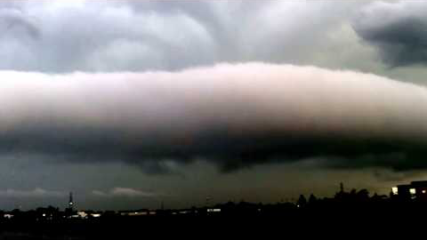
A roll cloud can form in the region of rain-cooled air just behind the gust front

Slide 16
Updraft base
Hail
Cold pool
‘Rain foot’
Stacey Hitchcock PECAN, 2015

Slide 17
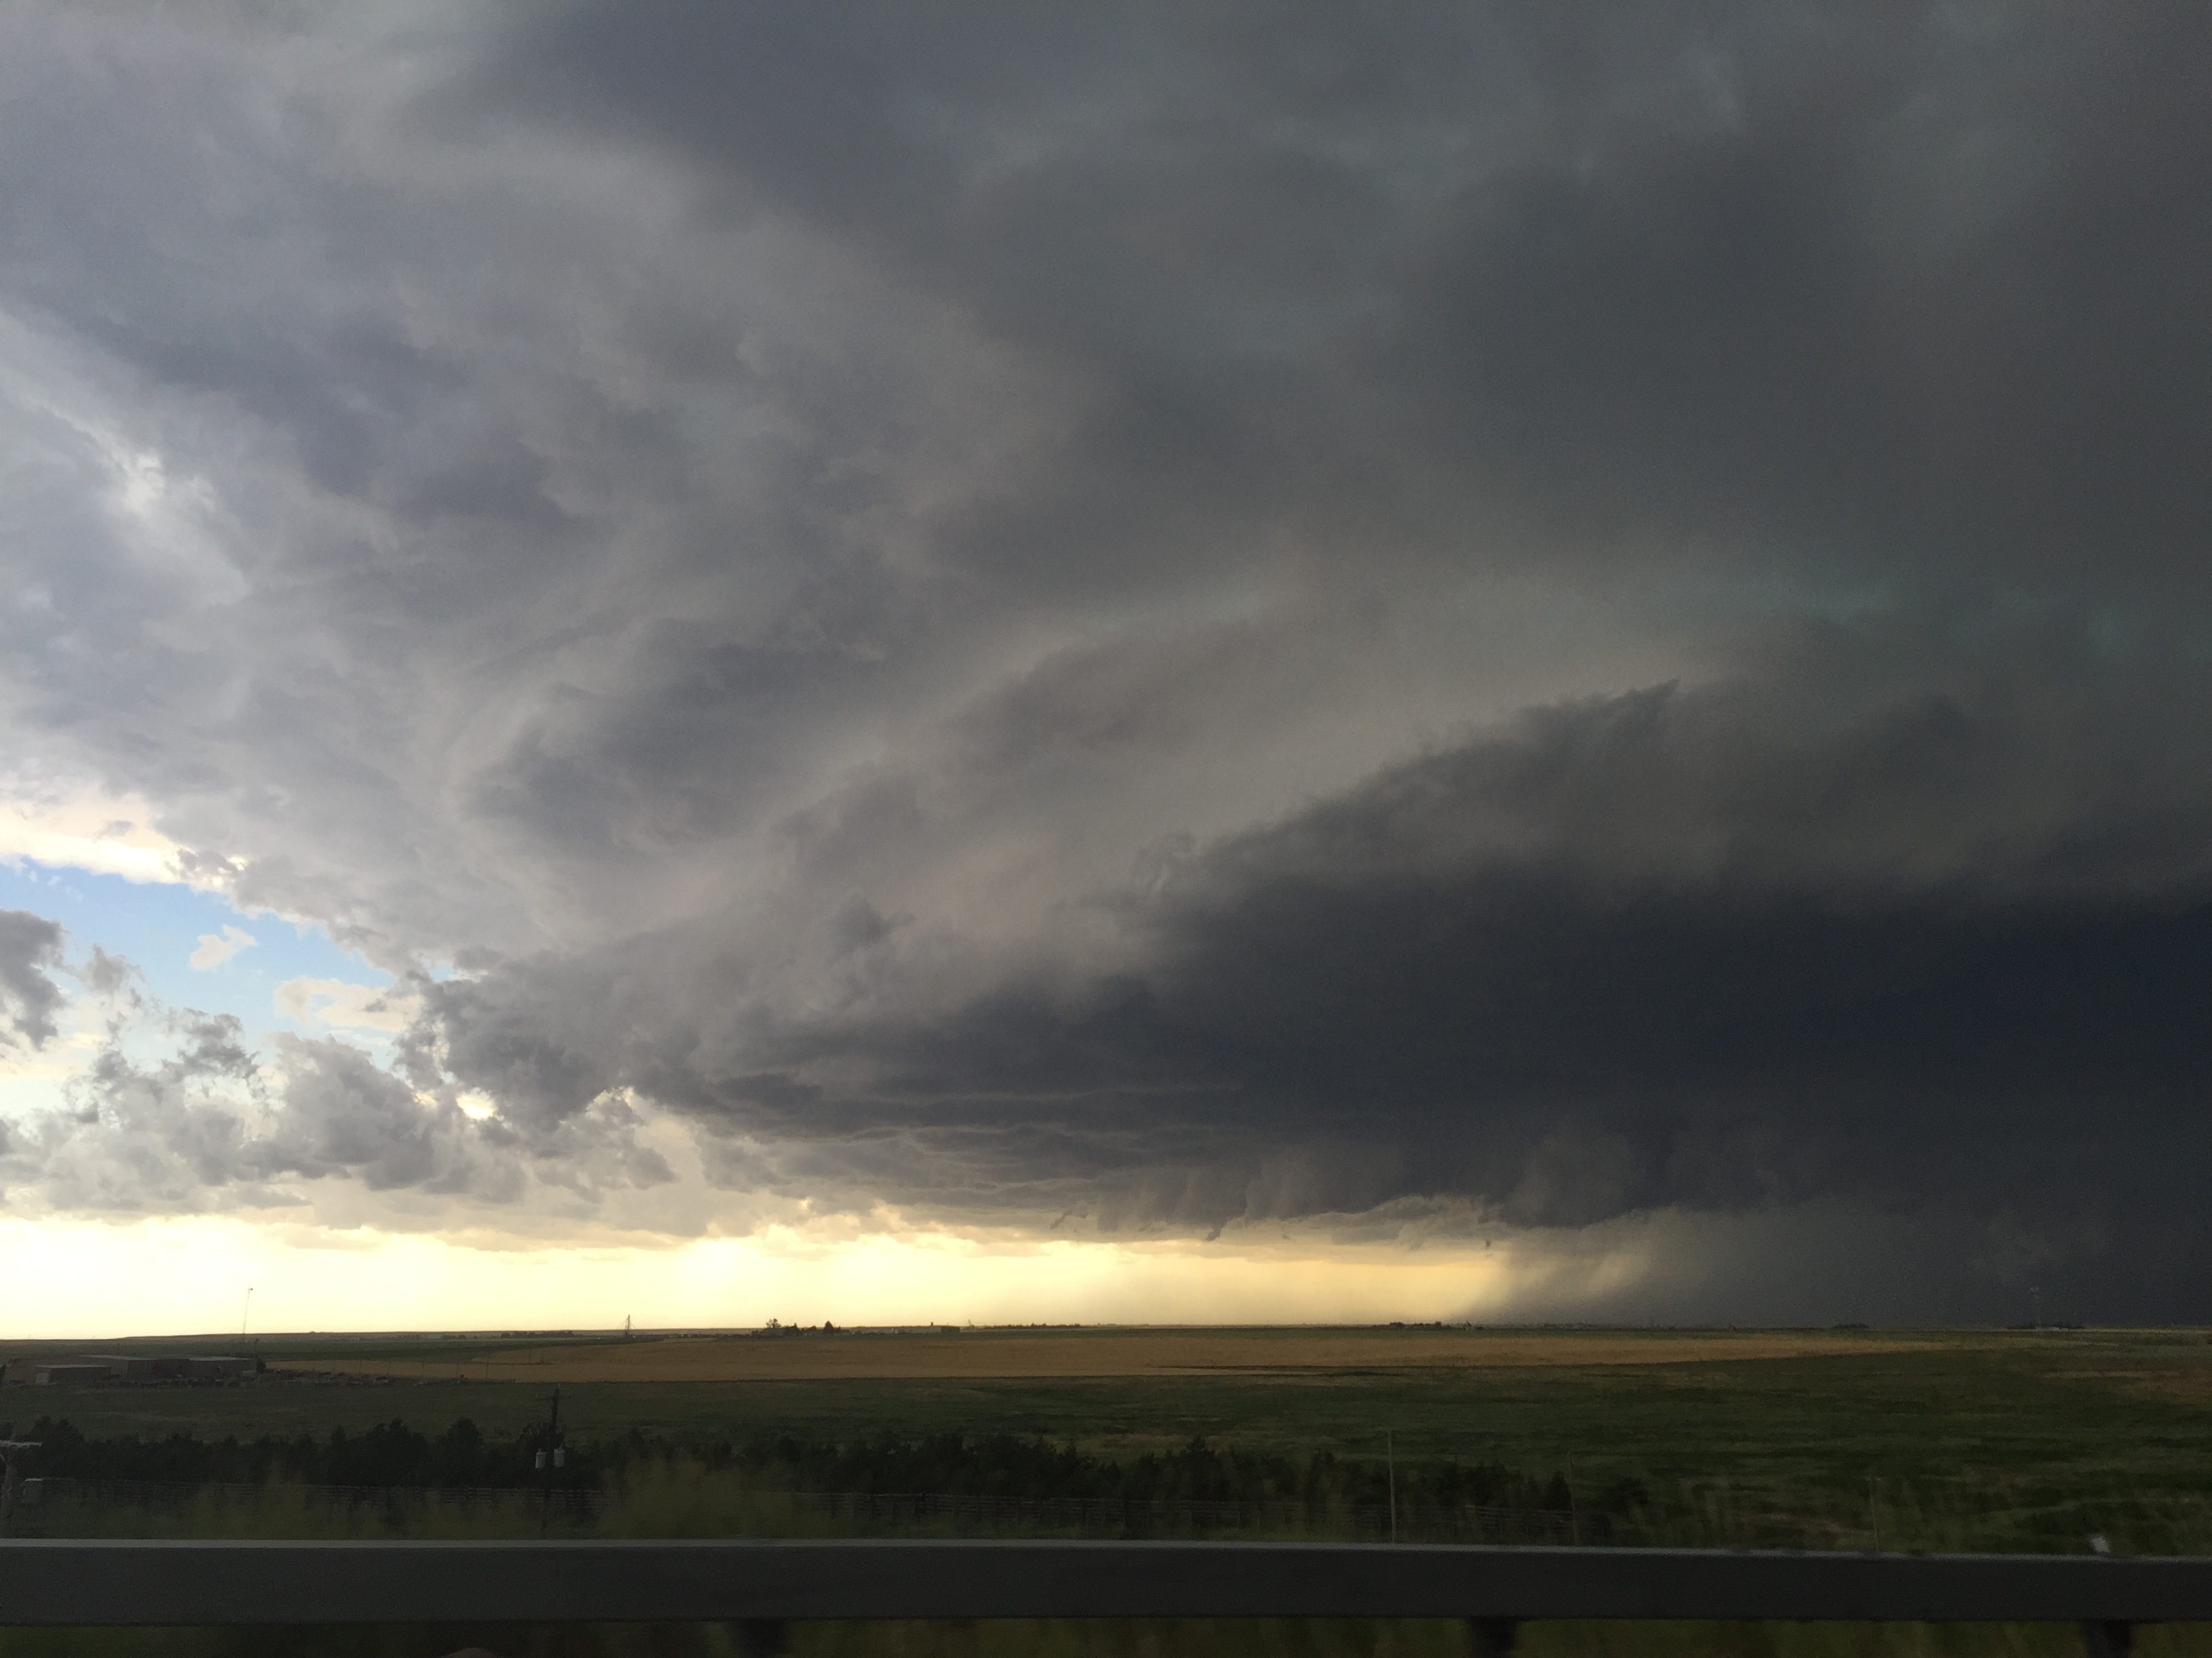
Evidence of hail

Slide 18
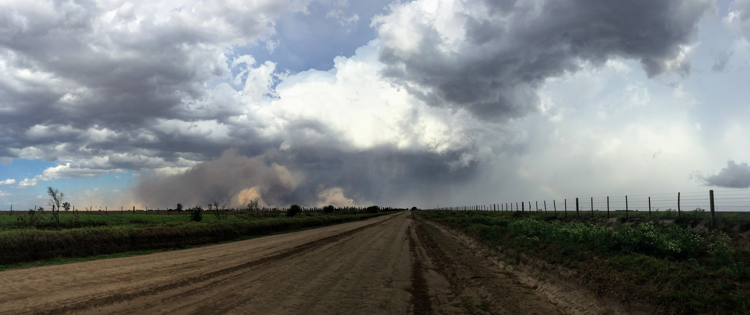

Slide 19
Mesocyclone (rotating updraft!)
Note clear striations, indicative of rotation
Inflow
Michael Coniglio, TORUS 2019

